Slide 1


DATA MANAGEMENT
PROJECT
Presented by: Komnas Kafasis
AM:3190081

Slide 2
OVERVIEW
01
02
03
Dataset
ETL process
Star Schema
04
05
06
Cube
Visualizations
Analysis models

Slide 3



DATASET

Slide 4
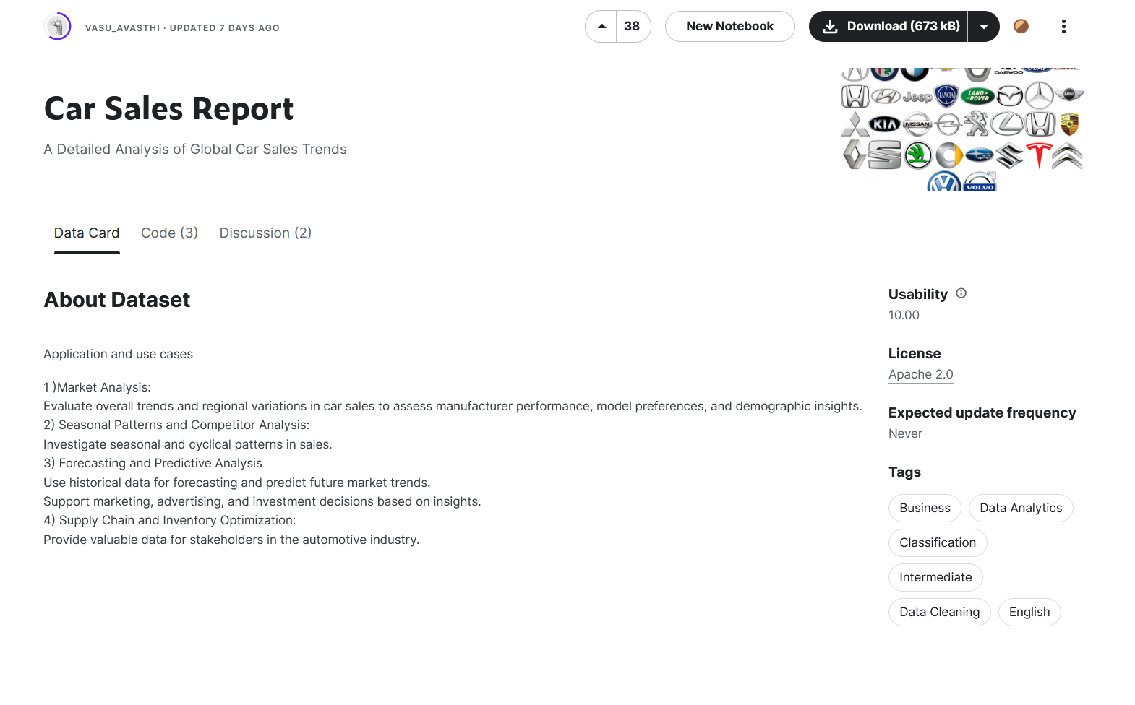
dataset link

Slide 5
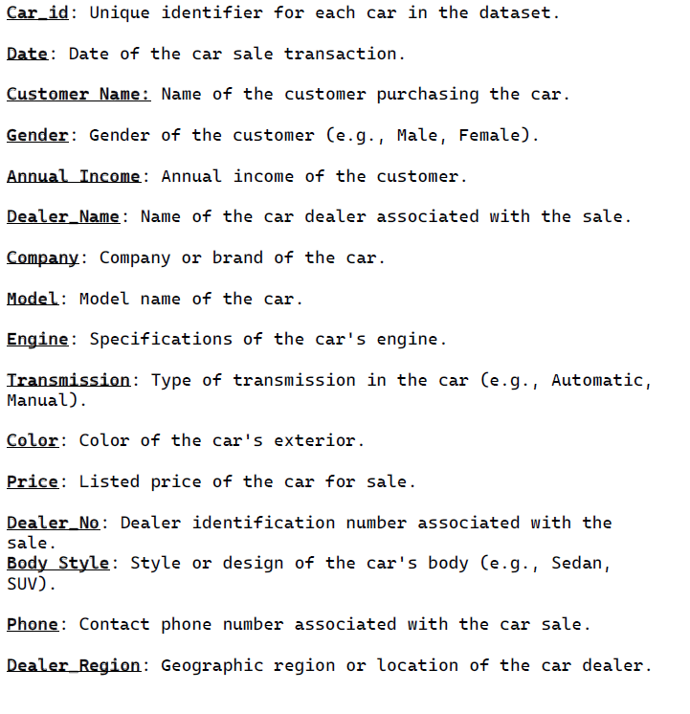

Slide 6
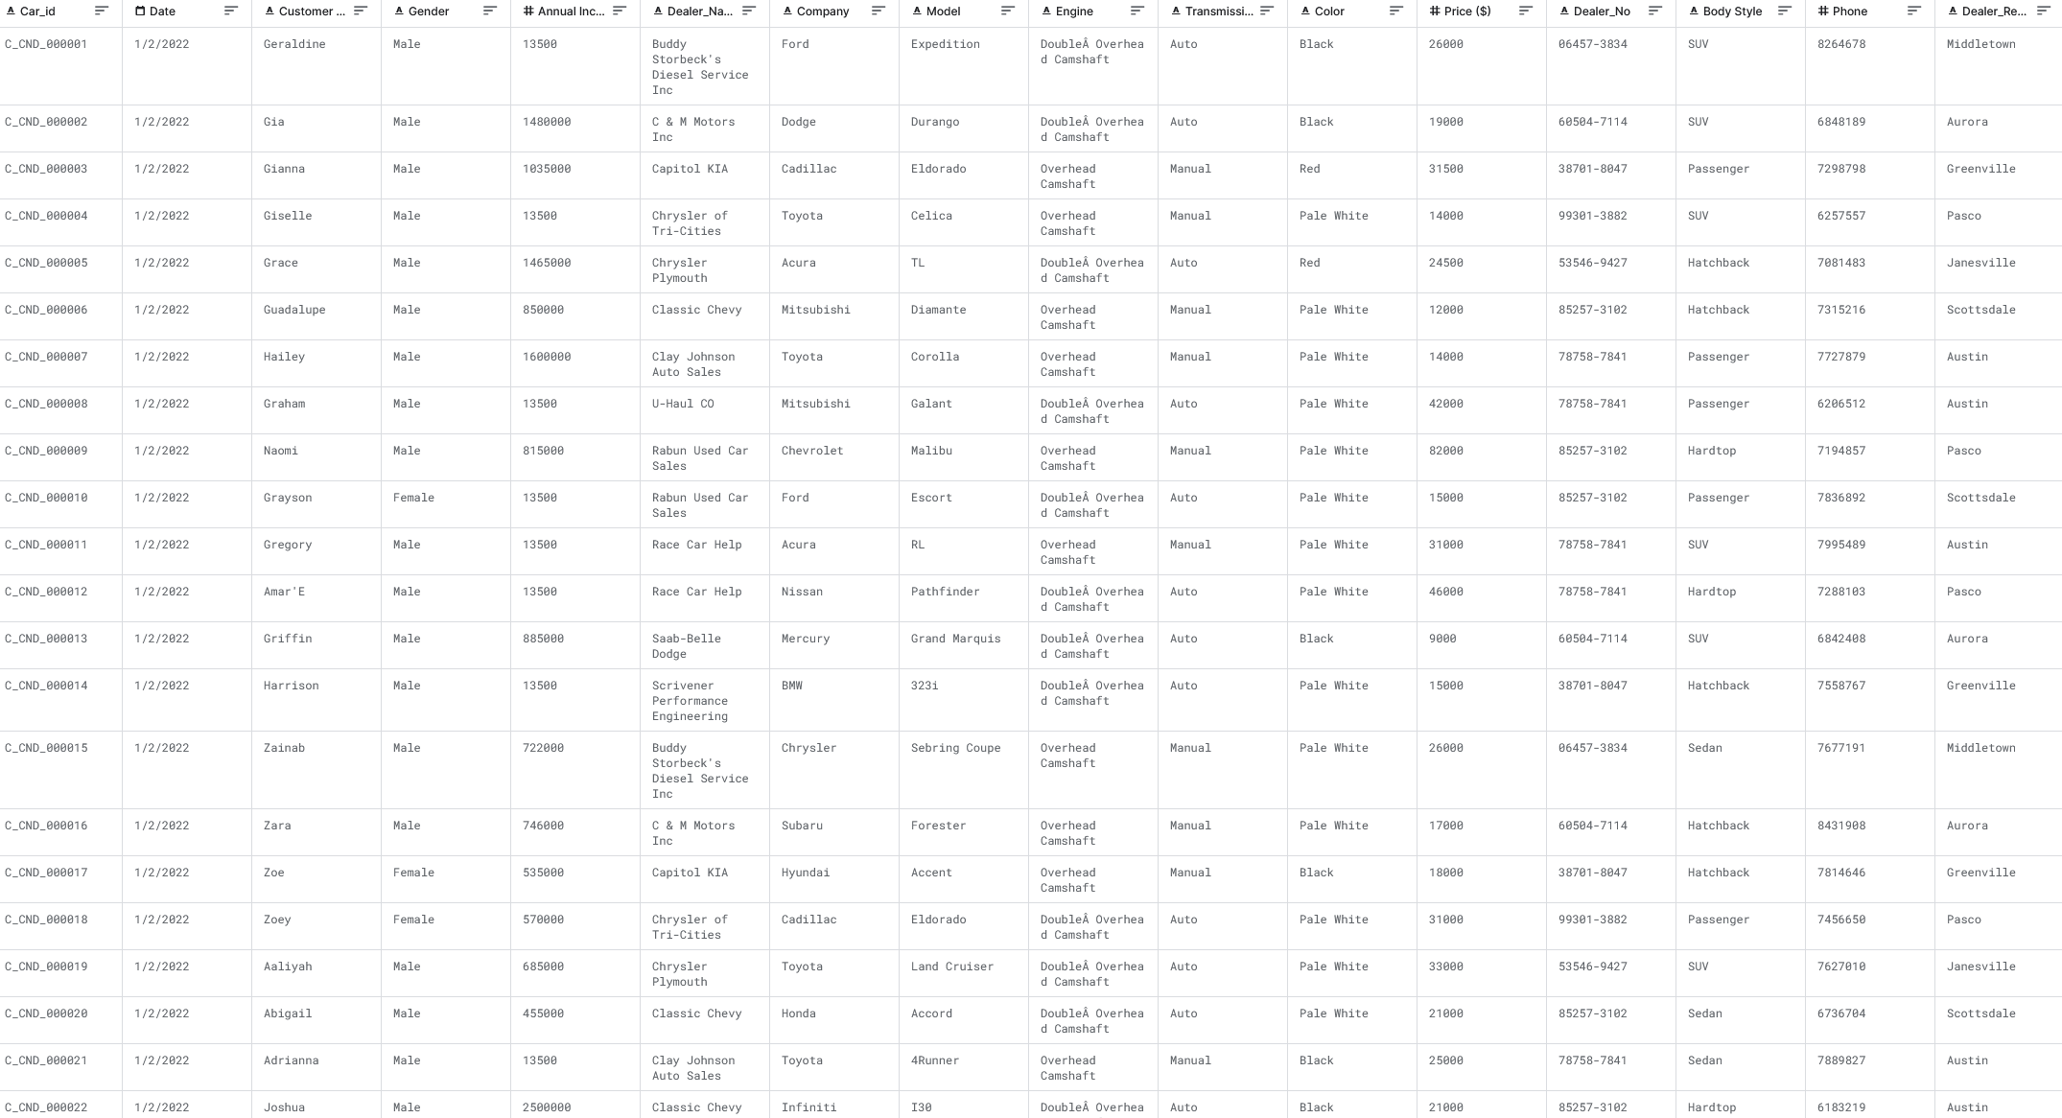

Slide 7
ETL PROCESS

Slide 8
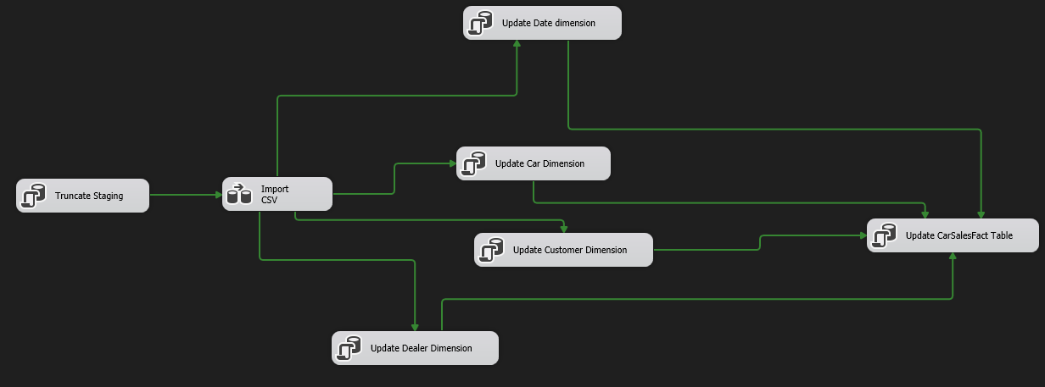
STEP 1: CREATE ETL PROCESS IN SSIS

Slide 9
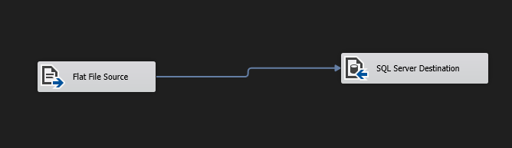
STEP 1: CREATE ETL PROCESS IN SSIS
IMPORT CSV DATA FLOW

Slide 10
STEP 2: DEPLOY SSIS PACKAGE
Created an Integration Services Catalog on SSMS
Deployed it using via the SQL Server Integration Services Project on Visual Studio

Slide 11
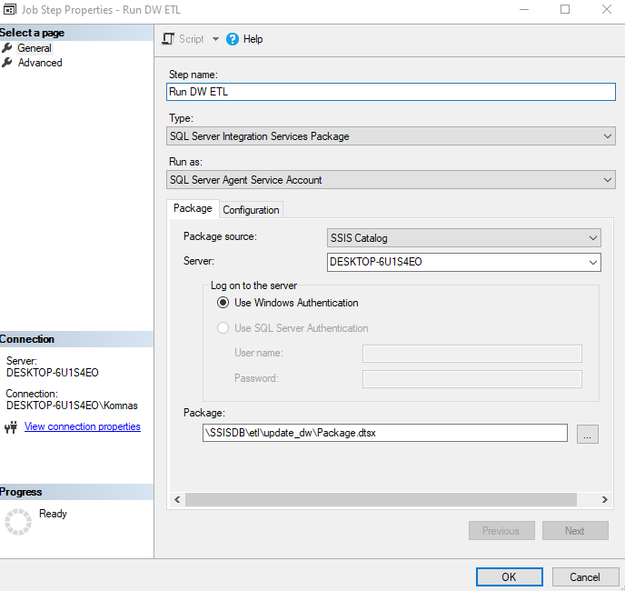
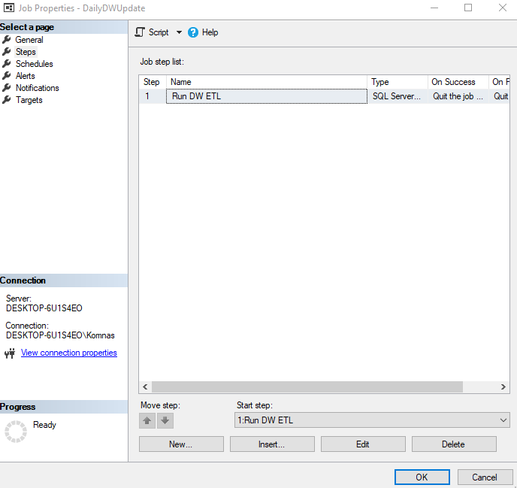
STEP 3: CREATE A JOB TO SCHEDULE
THE ETL PROCESS

Slide 12
STAR SCHEMA

Slide 13
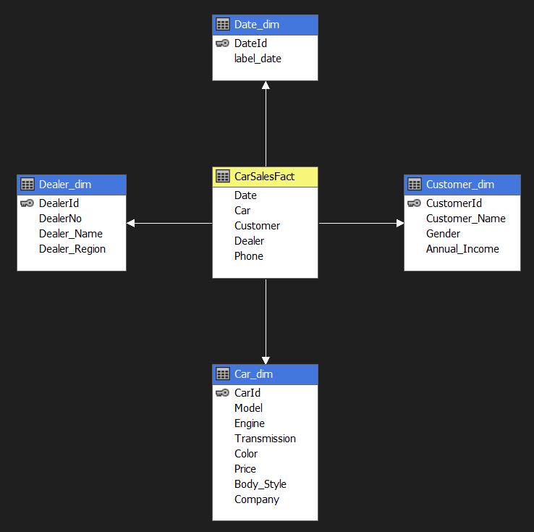

Slide 14
CUBE

Slide 15
STEPS
Set up an Analysis Services project on Visual Studio using the Microsoft Analysis Services Projects extension
Created a Data Source which would be the SQL Server
Created a Data Source View
Created the cube
Added the related columns as attributes to the dimension tables
Processed the cube
Added the cube processing to the etl process

Slide 16
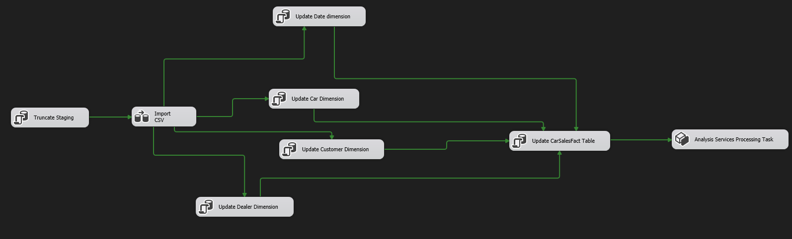
ETL Process with Cube Processing added

Slide 17
VISUALIZATIONS

Slide 18
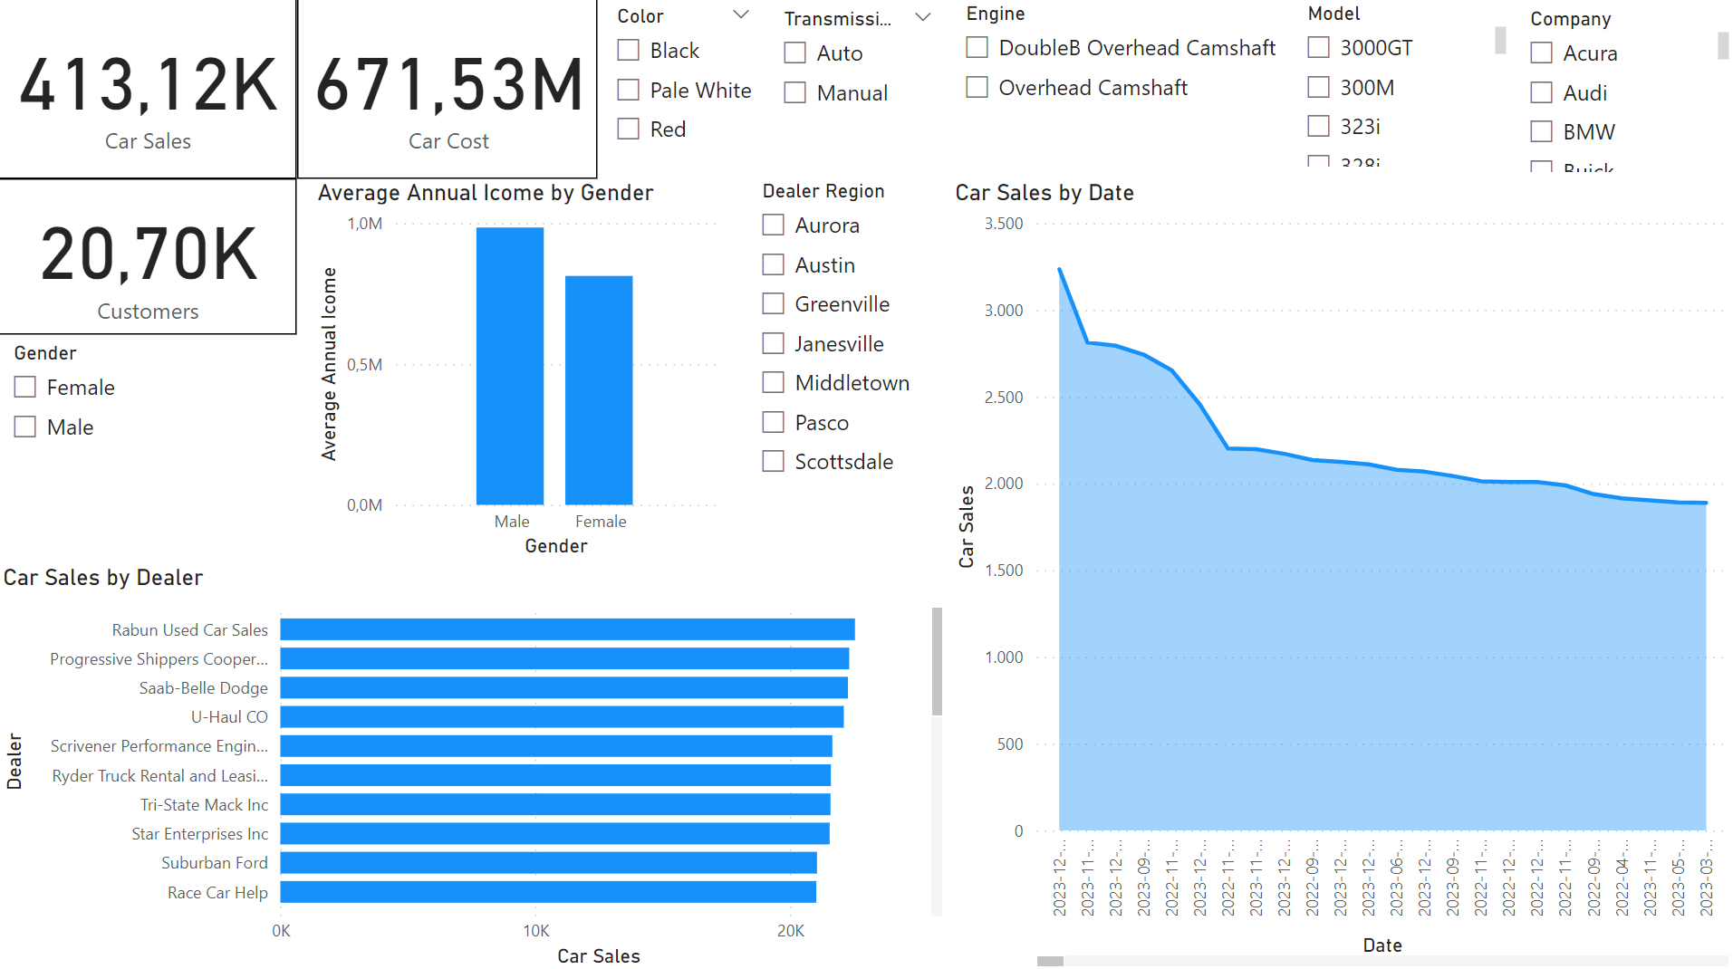

Slide 19
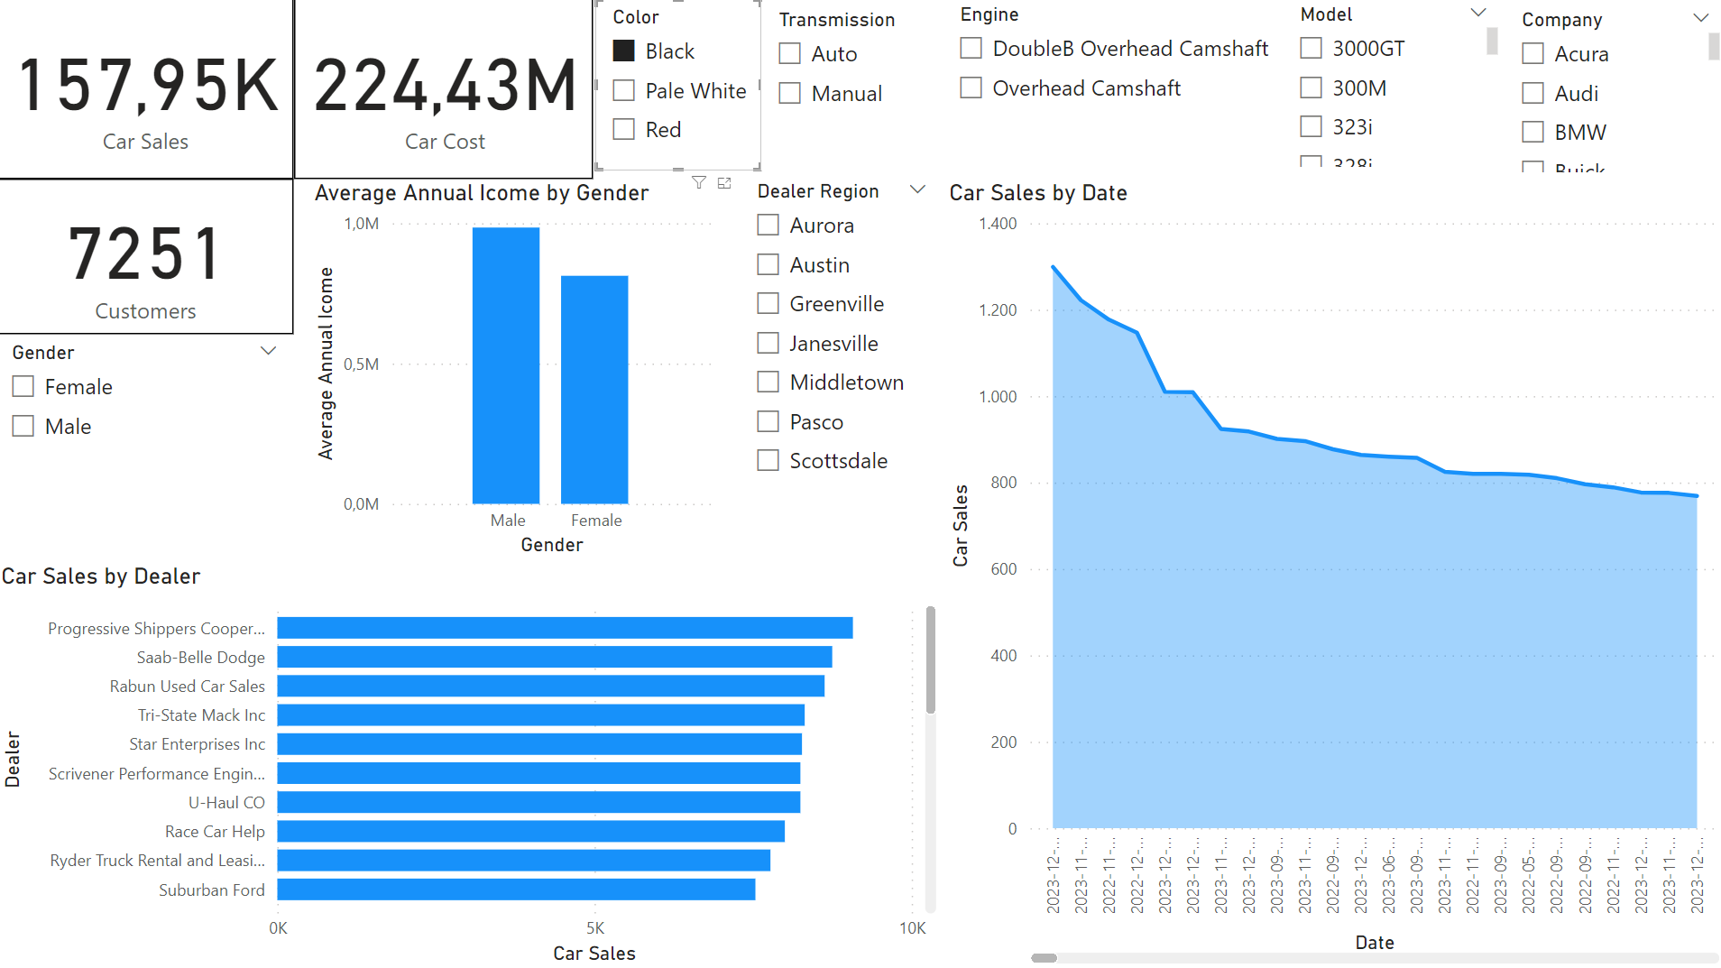
Select Color: Black

Slide 20
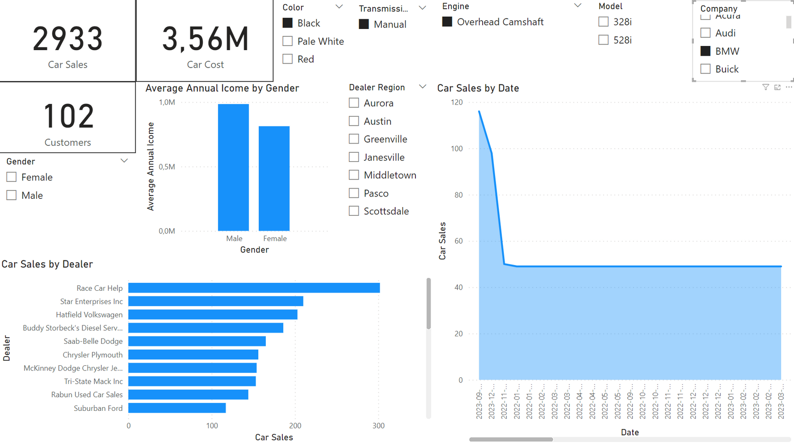
Select Color: Black
Select Transmission: Manual
Select Engine: Overhead Camshaft
Select Company: BMW

Slide 21
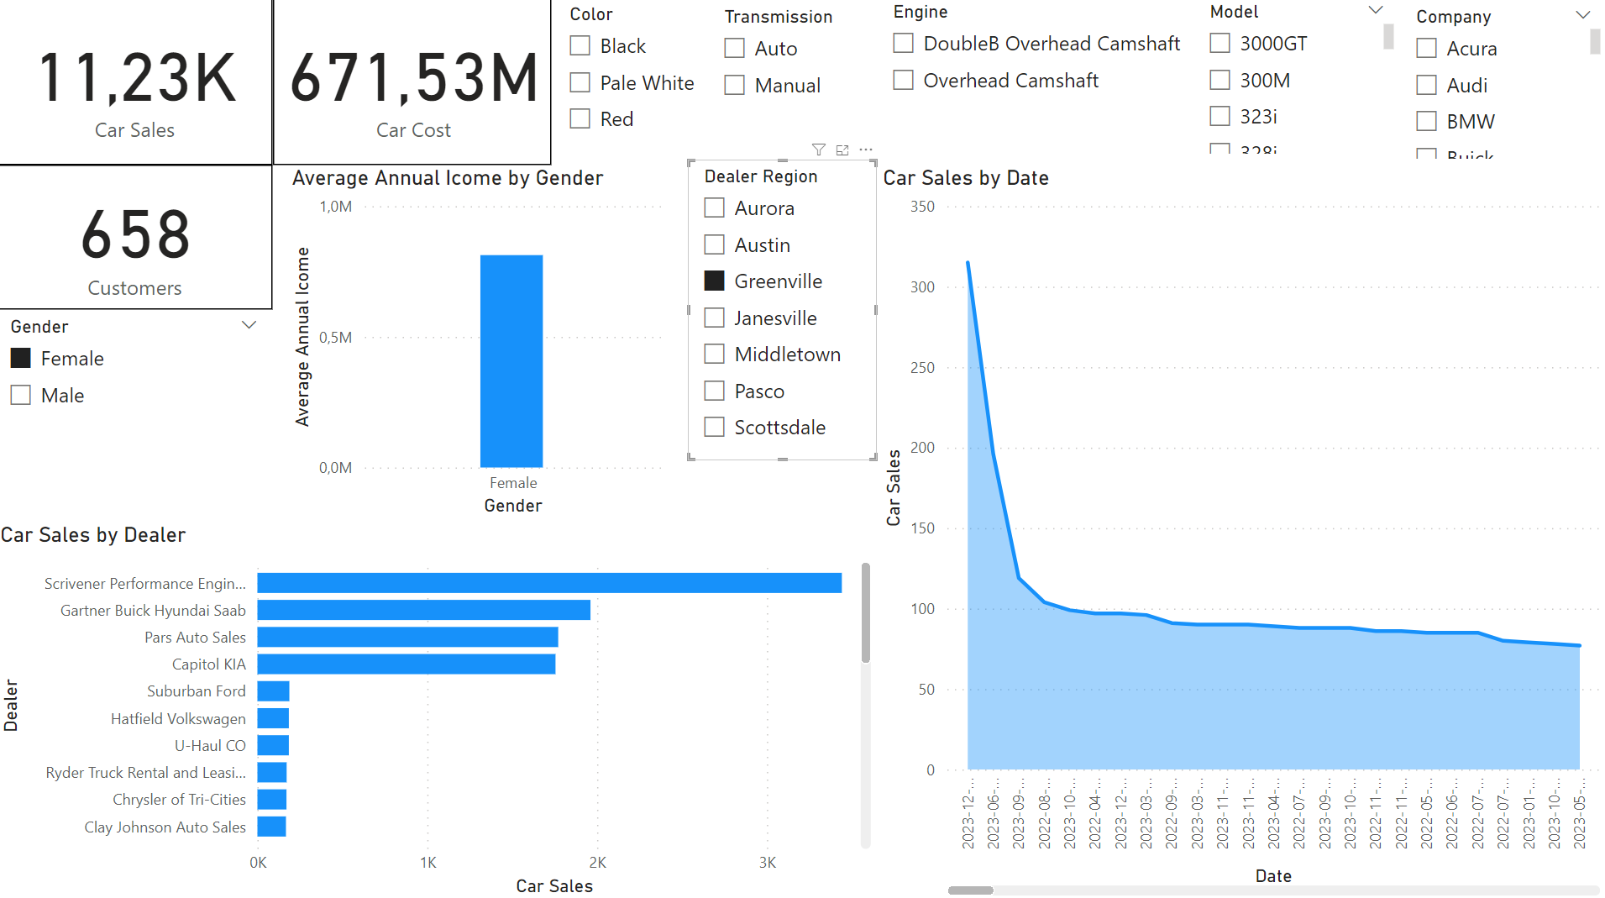
Select Gender: Female
Select Region: Greenville

Slide 22
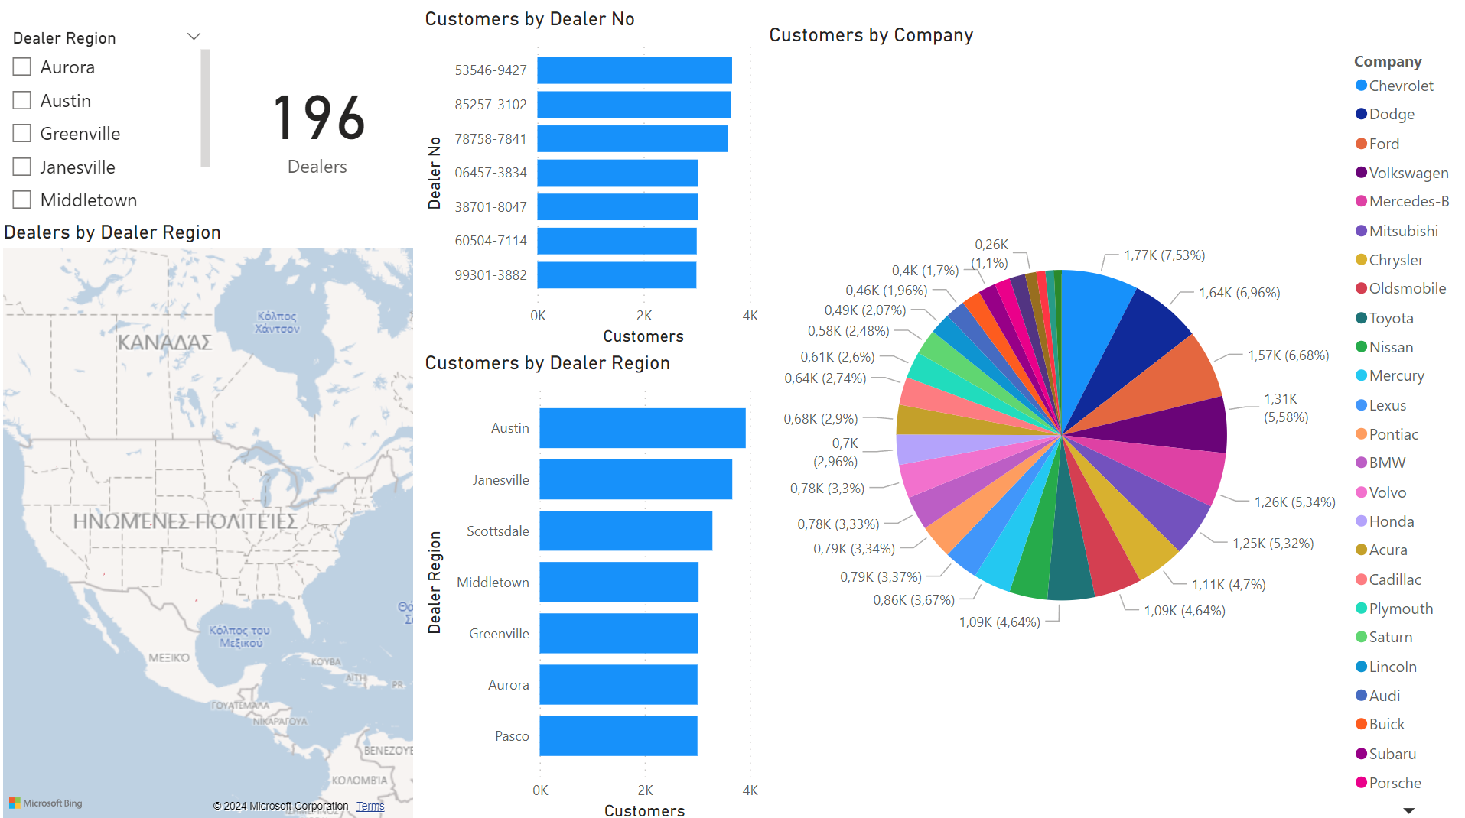

Slide 23
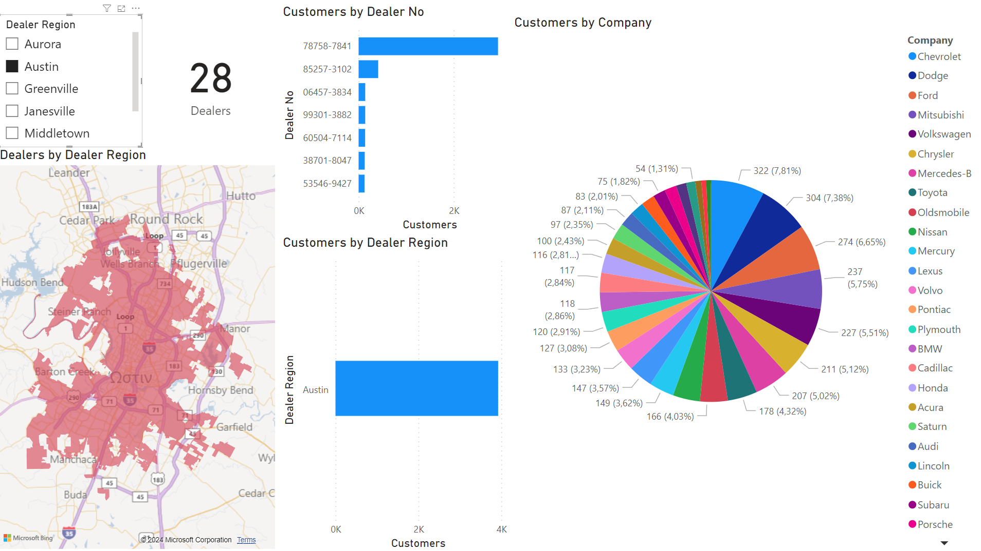
Select Region: Austin

Slide 24
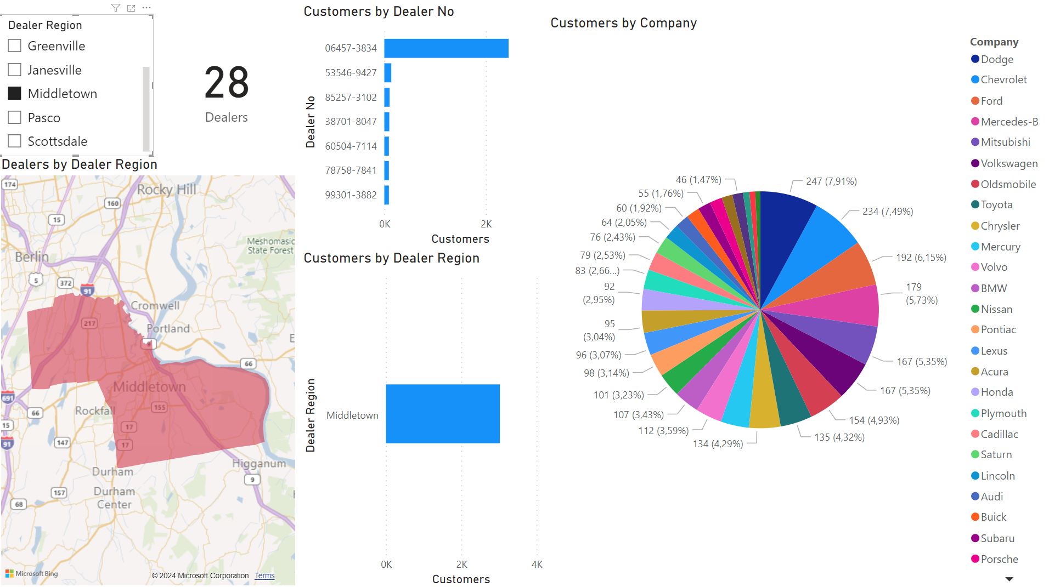
Select Region: Middletown

Slide 25
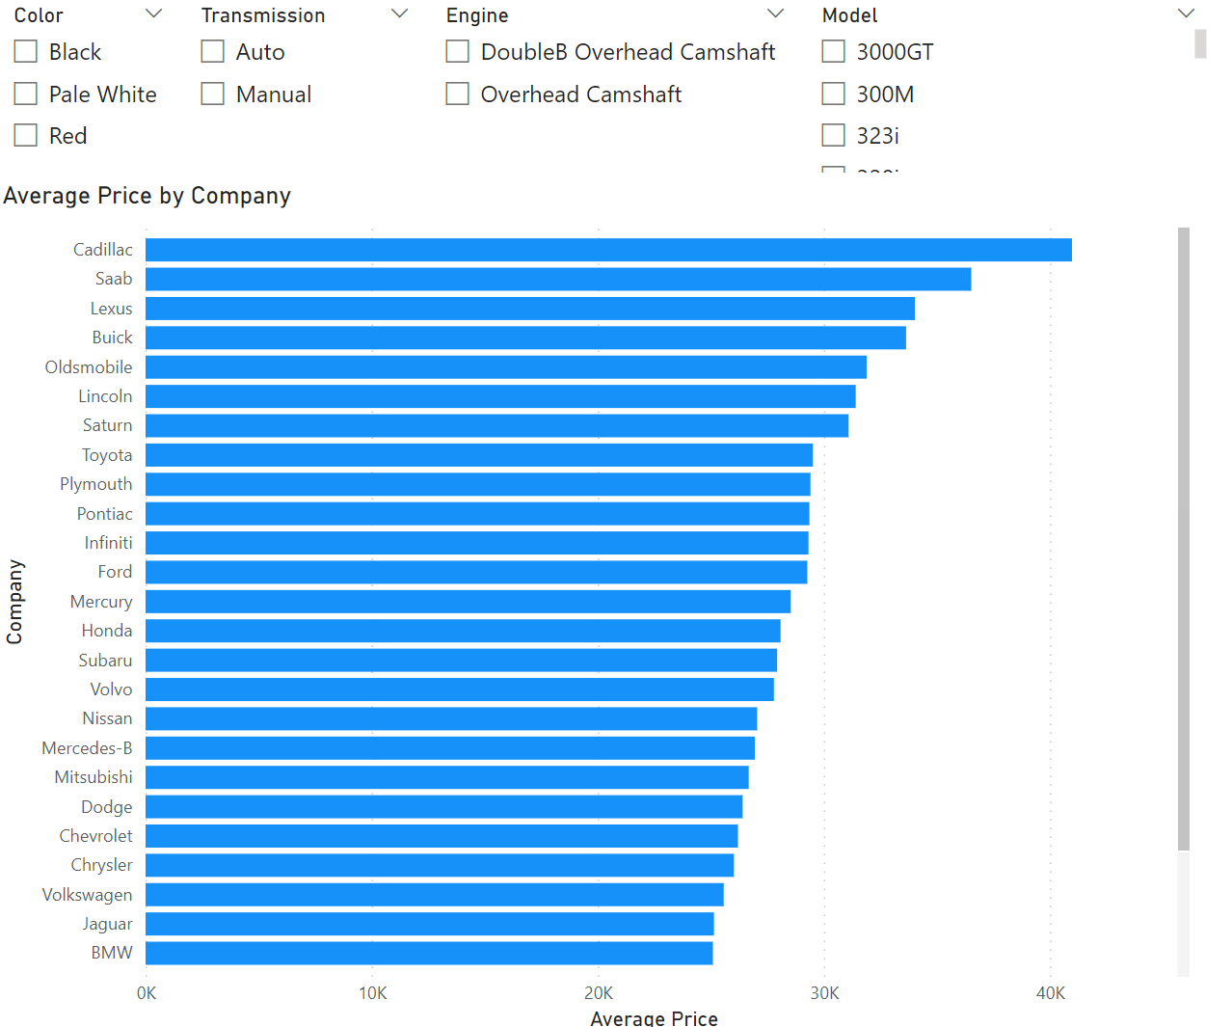

Slide 26
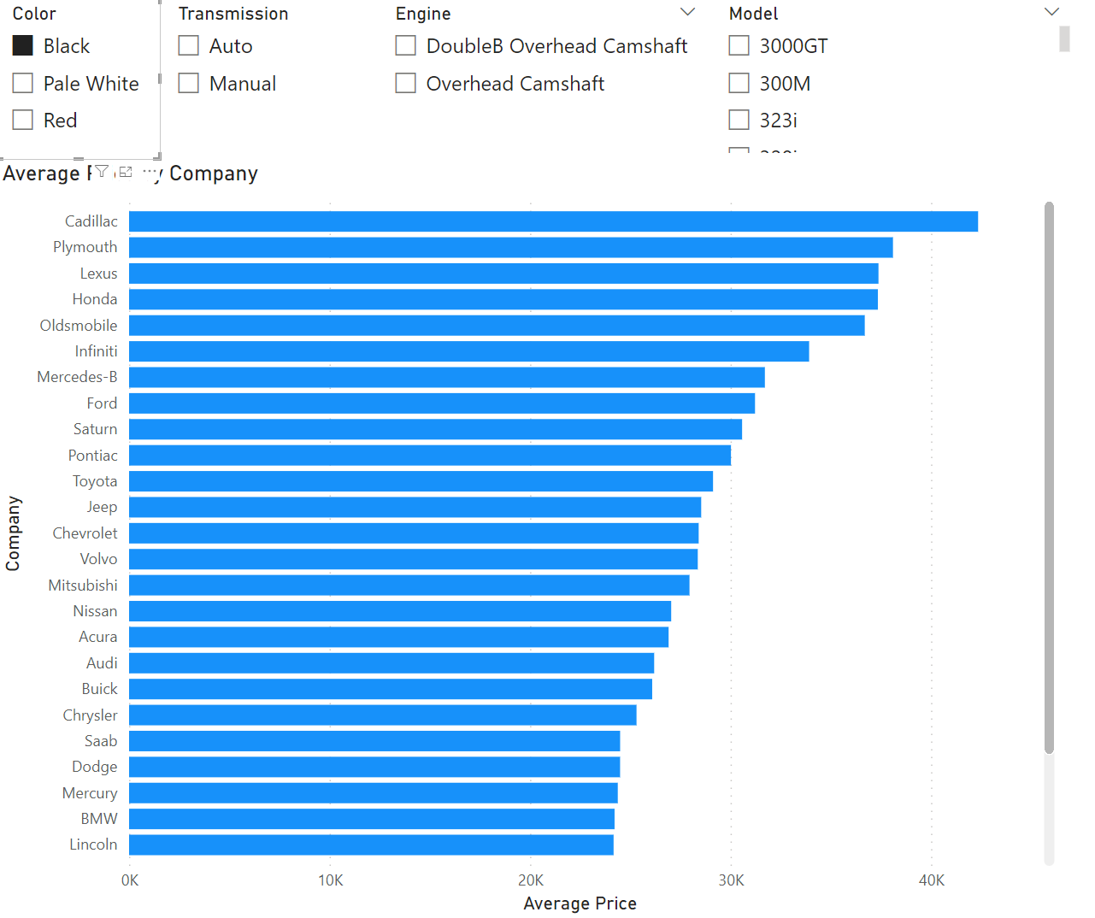
Select Color: Black

Slide 27
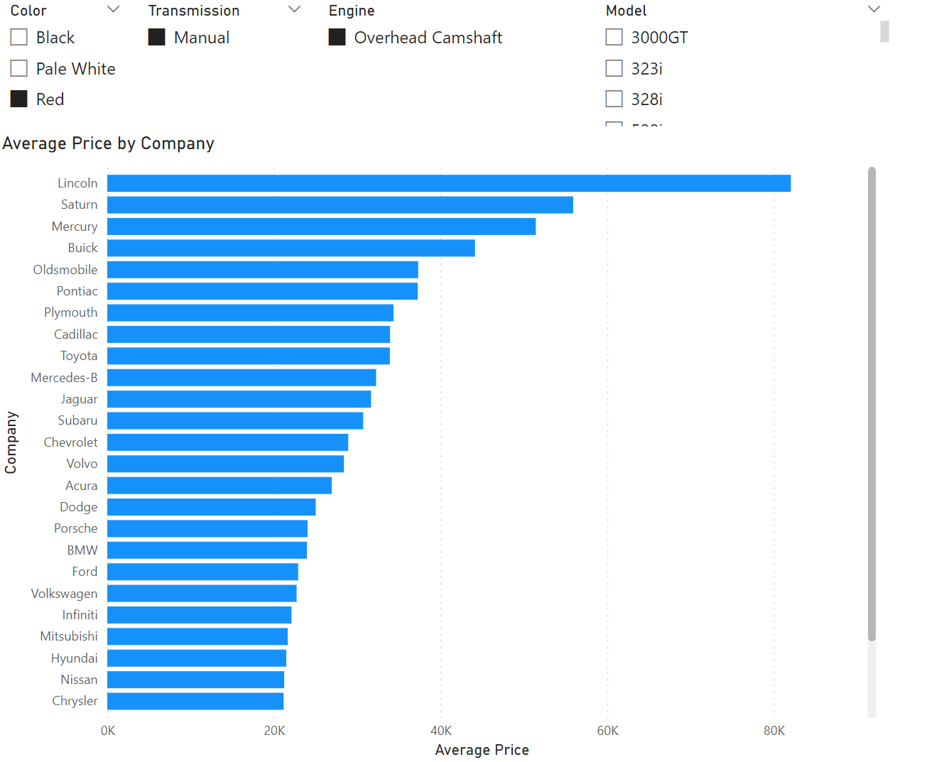
Select Color: Red
Select Transmission: Manual

Slide 28
ANALYSIS MODELS

Slide 29
Created 2 models
Clustering
Classification
Tool used: RadidMinerStudio
Used the Auto Model view

Slide 30
Clustering
Input columns:
Annual Income
Body Style
Algorithm: k-means
Clusters: 4

Slide 31
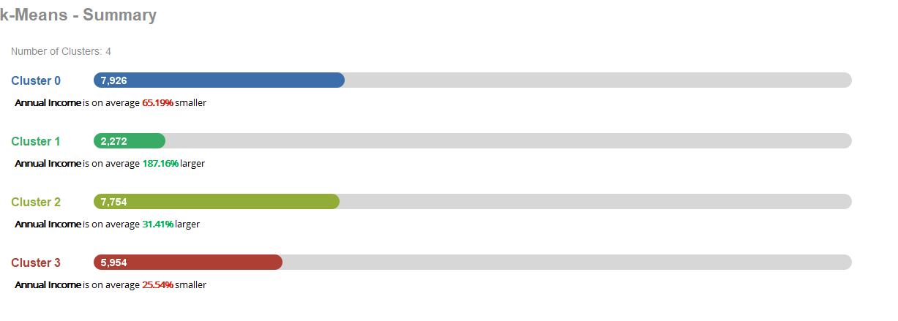

Slide 32
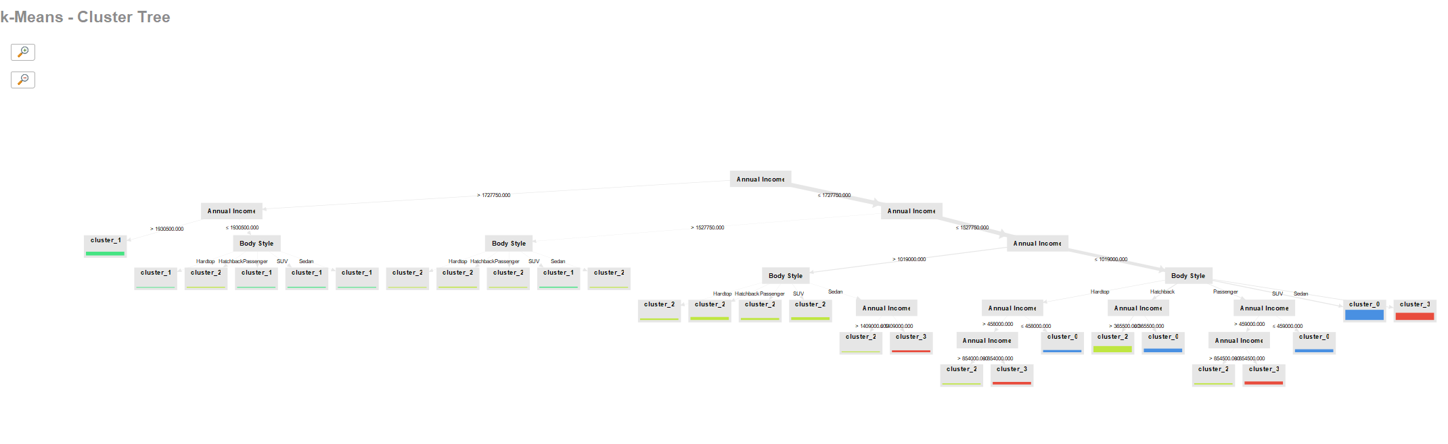

Slide 33
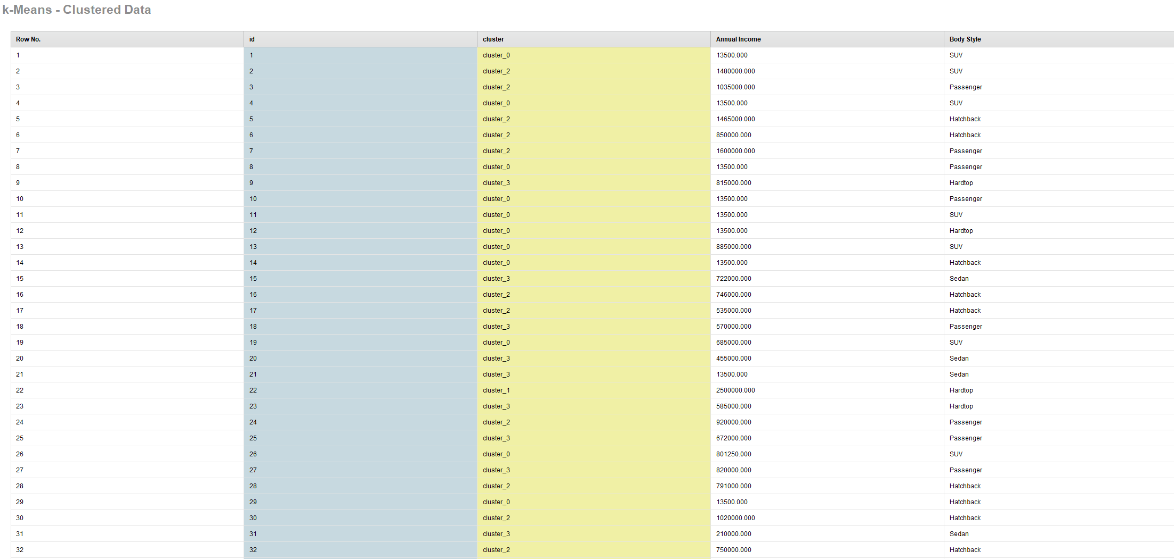

Slide 34
Classification
Prediction column: Transmission
Input columns:
Model
Body Style
Price
Algorithm: Naive Bayes

Slide 35
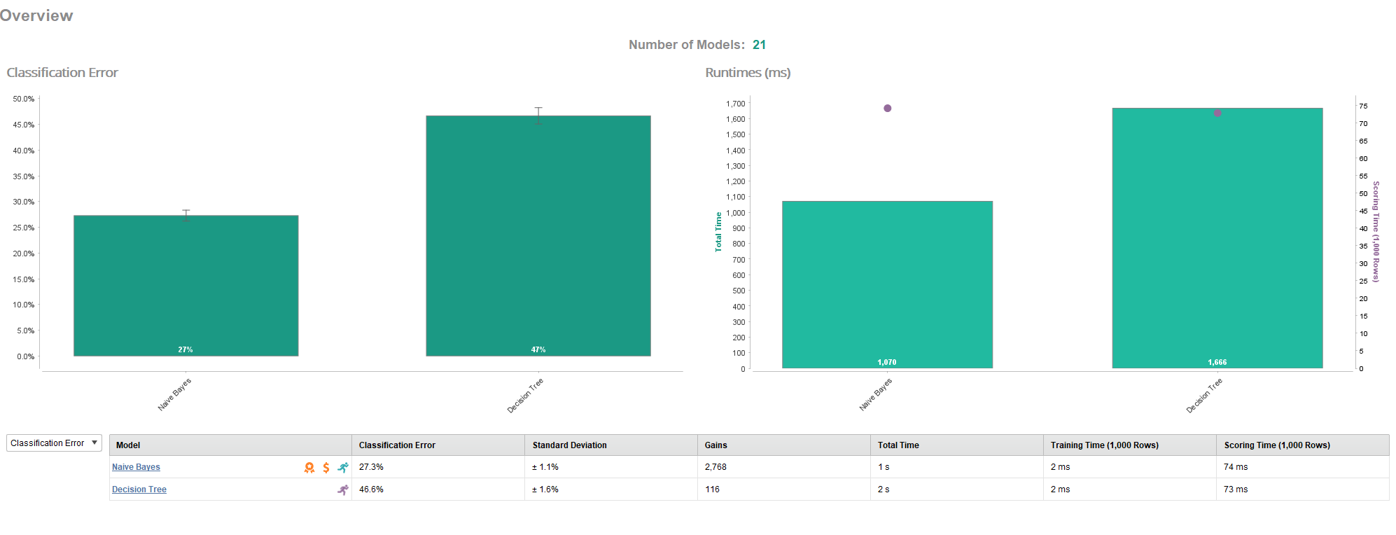

Slide 36
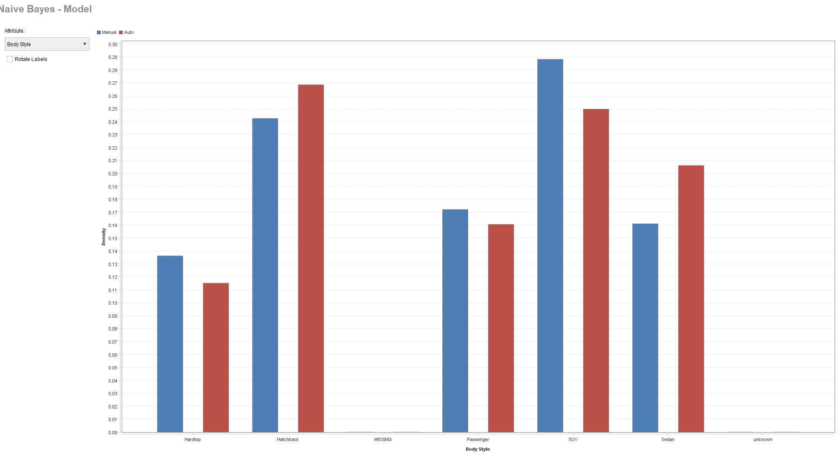

Slide 37
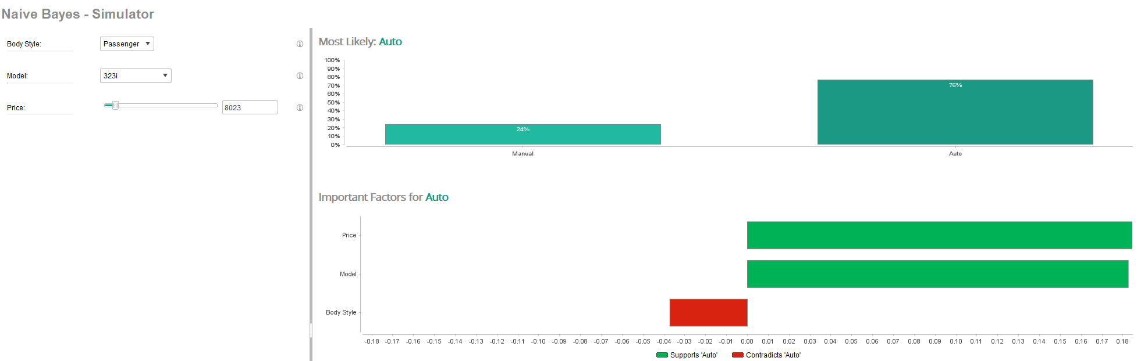

Slide 38
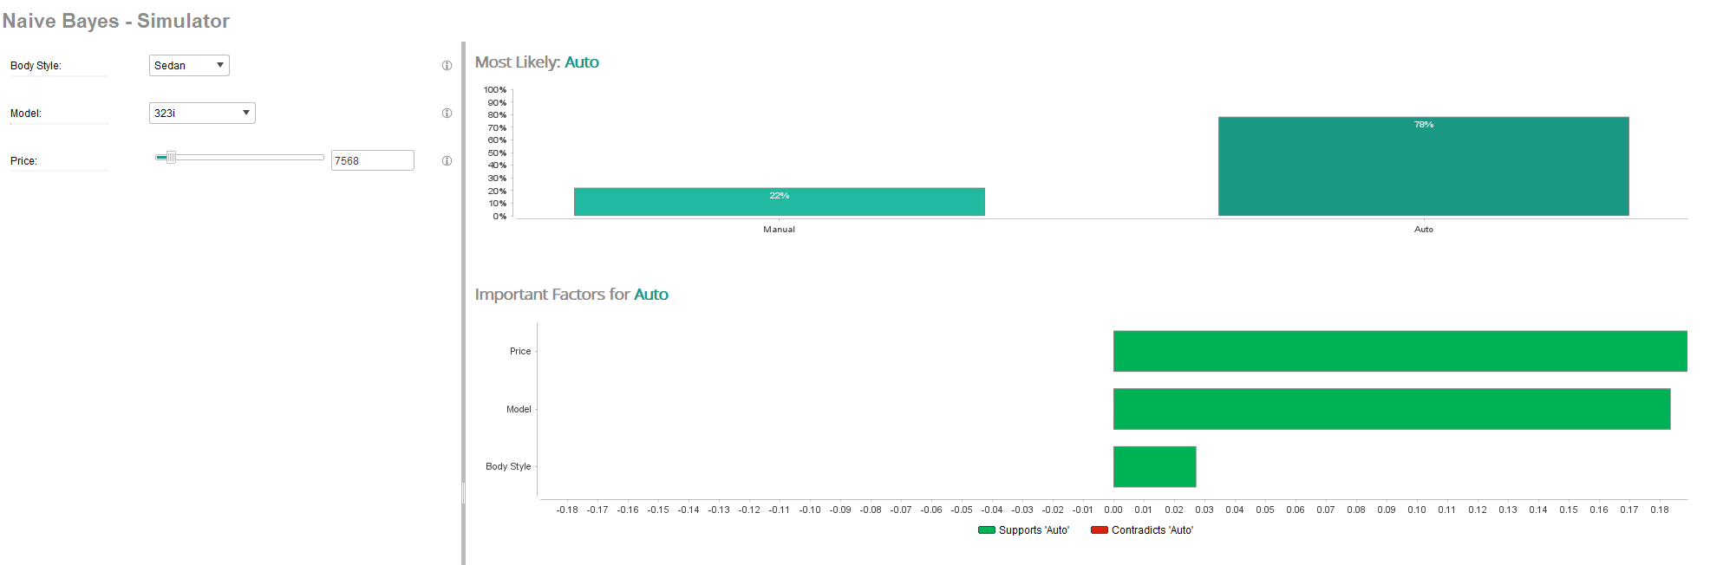

Slide 39
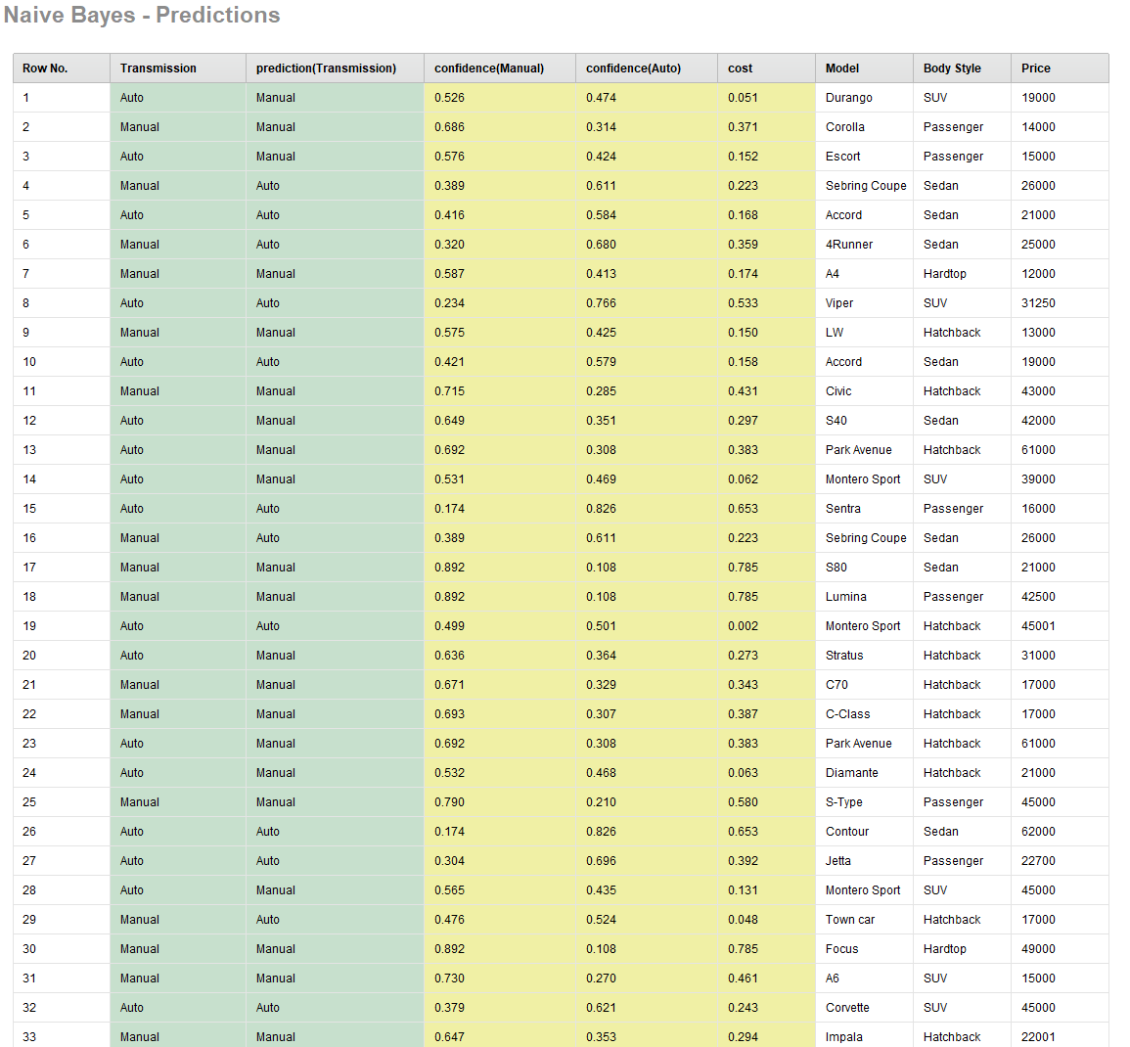

Slide 40
THANK YOU

